Slide 1
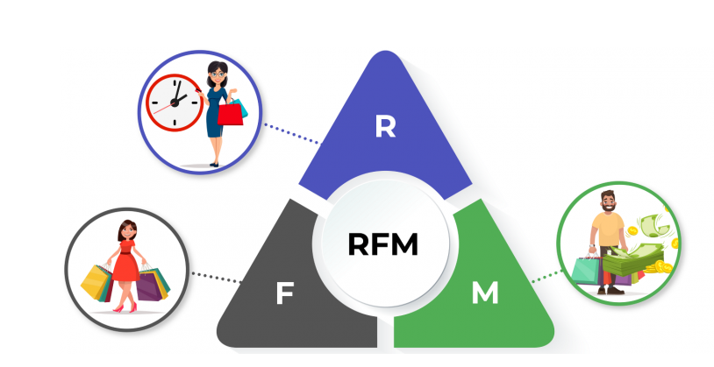
Customer segmentation using RFM

Slide 2
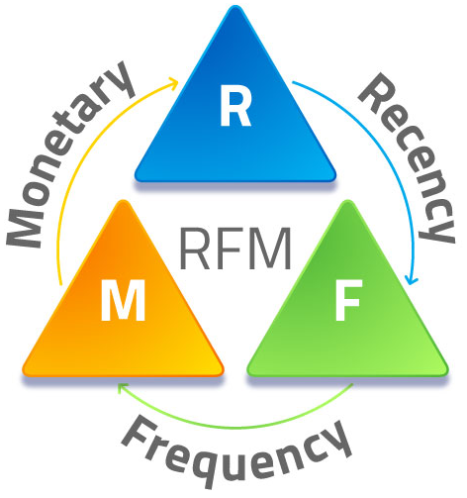
RFM
RFM ( Recency, Frequency, Monetary) analysis is a customer segmentation technique that uses past purchase behavior to divide customers into groups. RFM helps divide customers into various categories or clusters to identify customers who are more likely to respond to promotions and also for future personalization services.
RECENCY (R): we need to choose a date point from
which we evaluate how many days ago was the
customer's last purchase
FREQUENCY (F): calculating the frequency of frequent
transactions of the customer in ordering/buying some
product from the company
MONETARY VALUE (M): we are calculating the
monetary value of customer spend on purchasing
products from the company.

Slide 3
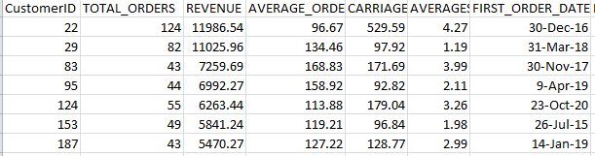
Data insights
The data is given as per below.
As seen in the data and particularly looking the customer ID , the customer visited
only one times .
The data have 5000 records and 40 features. We removed un-necessary data and
feature by using EDA.(pl see python file)

Slide 4
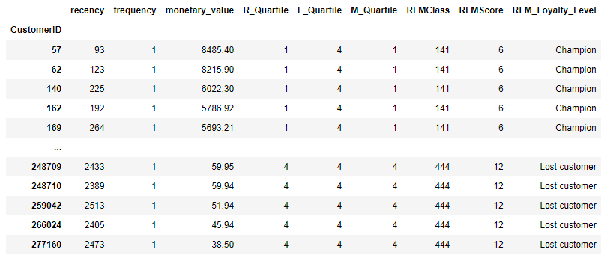
Customer Segmentation
As per identifying the customer segmentation using the RFM model we are coming
on below points
1.Customer group RFM value 141 , loyalty level is Champion which is the best group.
2.Customer with highest monitory value is kept at Top and loyalty level is Champion.

Slide 5
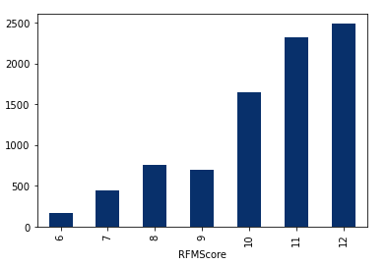
What decision company should take based on the data insights?
Based on this RFM module Customer with RFM value 141 are the best customer and
we can try to cross sale other products of our brand as well as we can encourage them
to sign for our loyalty program to enjoy some elite experiences like free same day
shipping ,Royalty access to newly launch product etc.
Other hand if the customer is falling to RFM class 444 then company may try to offer
some reward or coupon to trigger that spending from this almost churn out customer.
Here company also need to think to increase the frequency of customer.
Recency RFM score
R-scoring or Recency function, Lower
the value of RMS score is [141] or ‘6’ the
more loyal customer would be as well
as more engage he would be with
the brand.
Champion
Lost Customer

Slide 6
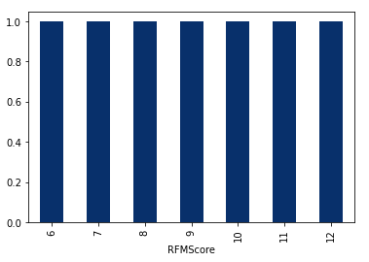
Frequency RFM score
As we are seen in graph and as I mentioned earlier that customer has visited
once time in the data. So that’s why frequency is 1.
The value of frequency always 4 because the customer here are transacted only 1 time.

Slide 7
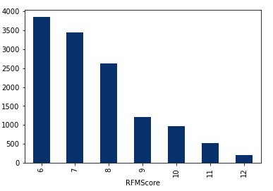
Monitory RFM score
Champion
We can see that Customer with highest monitory value is kept at Top or First and
loyalty level is also Champion.

